Slide 1
Automatic Paper Glass Fed Liquid Dispensing Machine
Prateek Shamprasad Pawar 2015BME002
Prasad Shamrao Deshpande 2015BME016
Bhagwan Panditrao Savandkar 2015BME017
Niranjan Mohan Mane 2015BME032
Manthan Nitin Dhisale 2015BME051
Under the Guidance of
Prof. P.B.Chougule

Slide 2
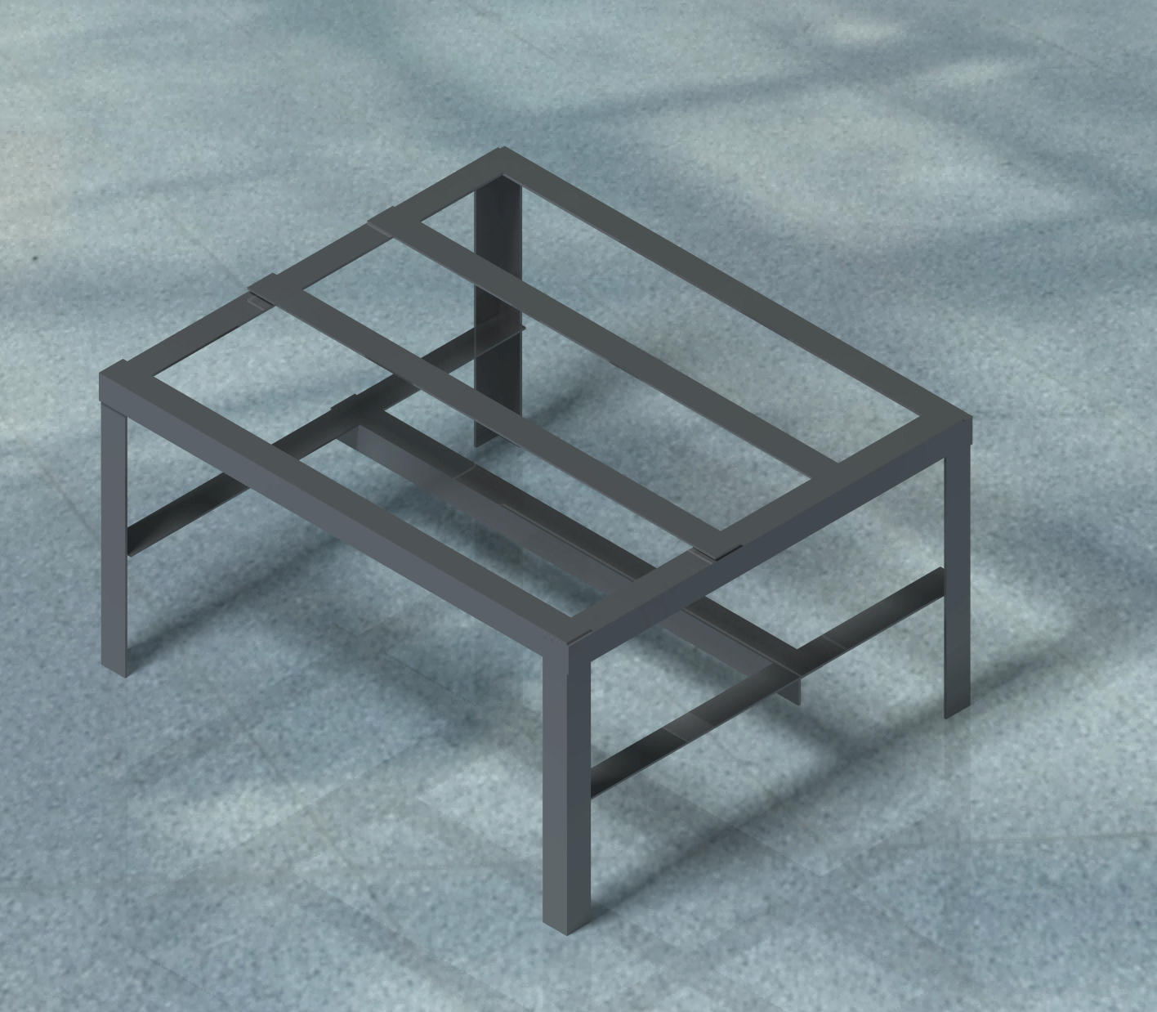
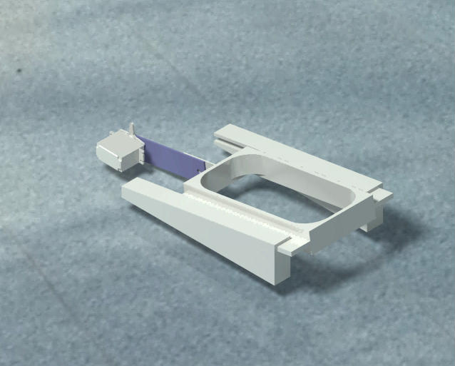
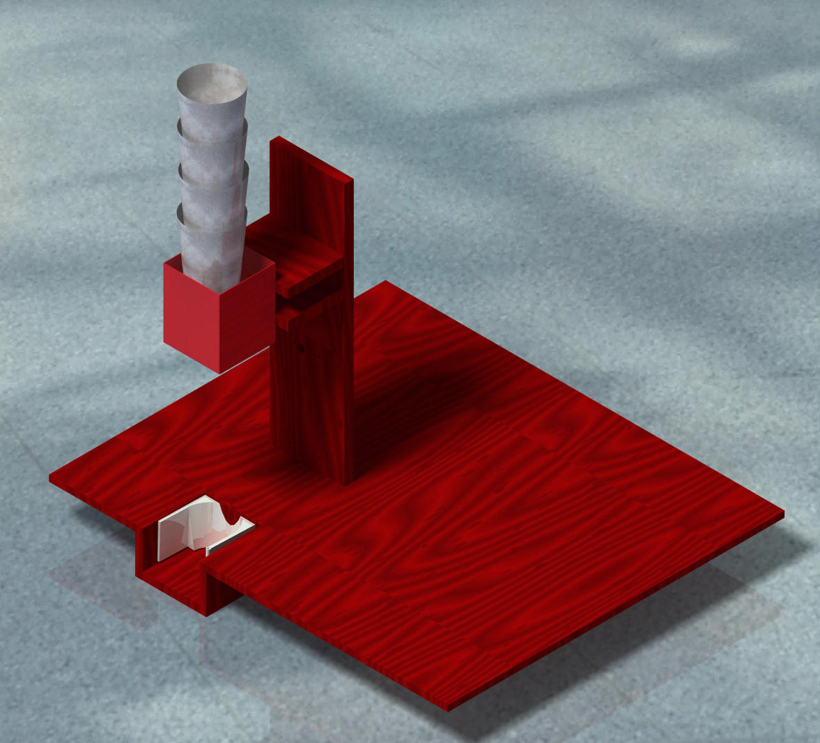
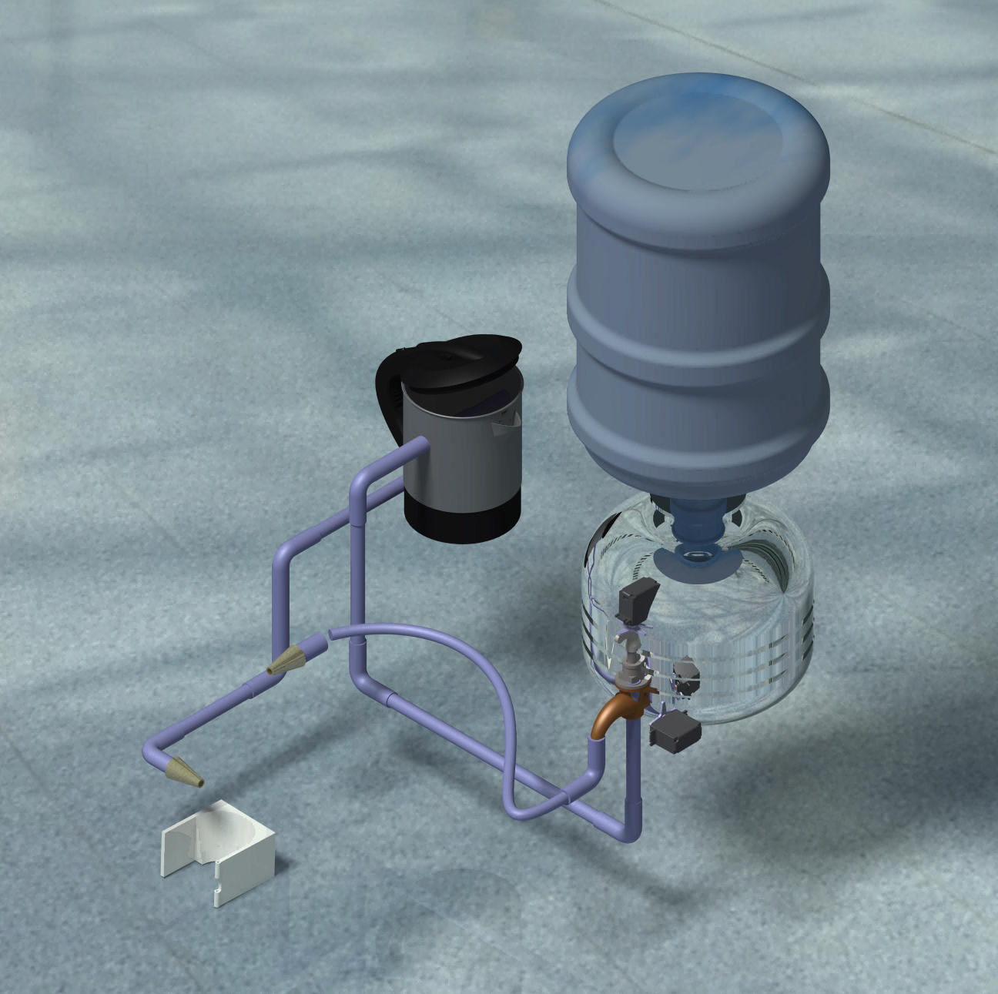
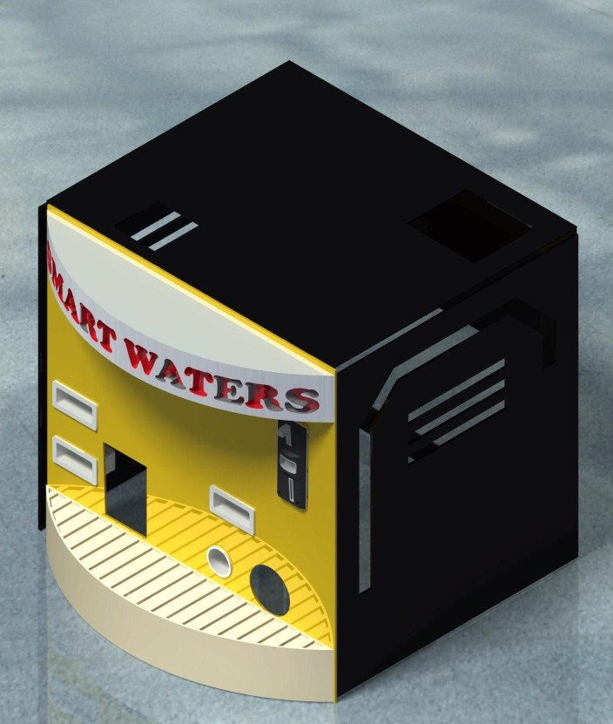
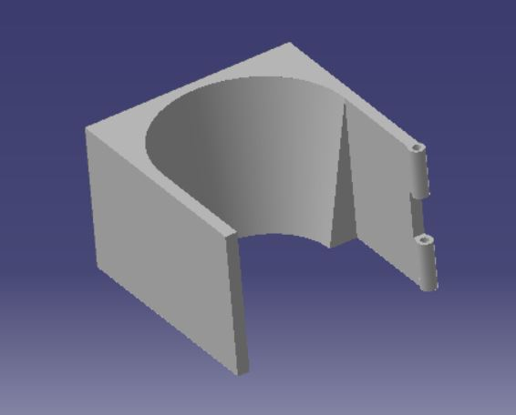
MANUFACTURING
3. GLASS STACK
5. PANELS
4. WATER CKT
2. SLIDER & CUP CATCHER
TRUSS

Slide 3
PROCESS PLANNING
Welding Truss
Sheet Metal Forming Sink
3D Printing Cup Catcher and Slider Mechanism
Bolting Panels and electronic components
CNC Router Cutting Panels
End Milling Heater Inlet and Outlet
Radial Drilling and reaming Dispenser, Glass stack stand
Adhesive Bonding Plumbing PVC pipes and Bibcocks
Cutting, Grinding Truss, Cup guider, acrylic, etc
Soldering Wires from wifi module, Arduino, Relay, SMPS etc to the supply

Slide 4
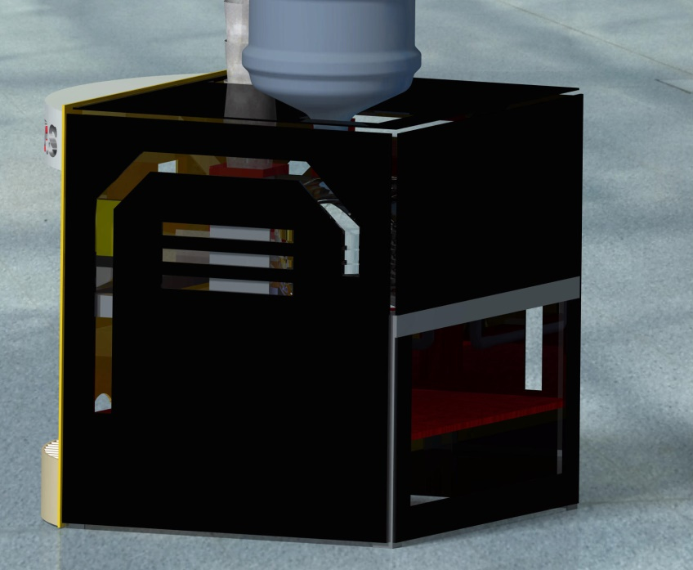
DESIGN for SERVICING
Top Slider
A. Back Door
Easy access to remove thrown glass
To collect coins entered
To access the electronic ckt
B. Top Slider
Easy access to critical parts such as coin detector
Water Bottle (Dispeneser) and Glass stack easy repair
Service Door
at back

Slide 5

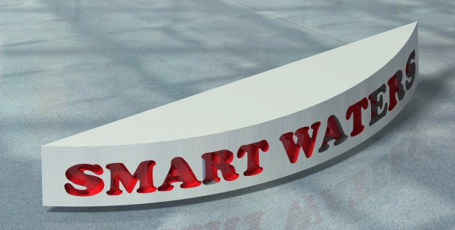
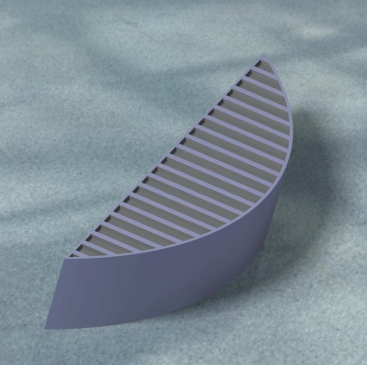
AESTHETIC
Slots along with vents in Panels Consist of
Aluminium Composite Polymer (ACP) Sheets
Arc Shaped Smart Waters
Water Sink in shape of Rib

Slide 6
ERGONOMICS

Slide 7
FINANCE

Slide 8
USP

Slide 9
THANK YOU

